Slide 1
Warm-Up
Using the Venn Diagram you have been given, place each statement in the appropriate place.
Average blood pressure | Who received high school diplomas | Right-handed or left-handed
Favorite TV show | Hours spent outdoors each day | Time of day you go to bed
Age group | Whether or not people smoke | Favorite food
Common majors in college | Average calories consumed in a day | Gender
Population | Number of brothers and sisters | Height
Shoe size | Hours spent doing HW each night | Miles from home to school

Slide 2
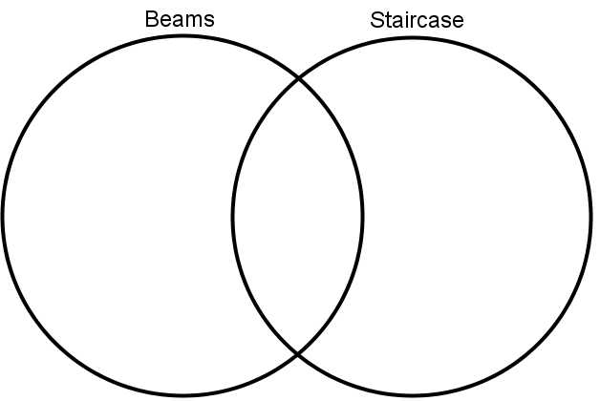
Categorical
Quantitative
Favorite TV Show
Average blood pressure
Age group
Population
Shoe size
Common majors in college
Hours spent outdoors each day
Who received high school diplomas
Average calories consumed in a day
Whether or not people smoke
Number of brothers and sisters
Hours spent doing HW each night
Right-handed or left-handed
Time of day you go to bed
Favorite food
Gender
Height
Miles from home to school

Slide 3
Two-Way Tables
Two-tables are used to examine the relationships between two categorical variables. A two-way table has a column variable and a row variable.
 | Facebook | Twitter | YouTube | Total
Male
Female
Total

Slide 4
There are two types of frequencies included in the table: joint frequencies and marginal frequencies.
 | Facebook | Twitter | YouTube | Total
Male | Number of males who prefer Facebook | Number of males who prefer Twitter | Number of males who prefer YouTube | Total number of males
Female | Number of females who prefer Facebook | Number of females who prefer Twitter | Number of females who prefer YouTube | Total number of females
Total | Total number of people who prefer Facebook | Total number of people who prefer Twitter | Total number of people who prefer YouTube | Total people surveyed

Slide 5
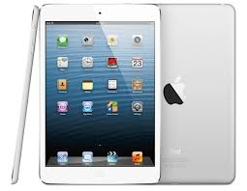
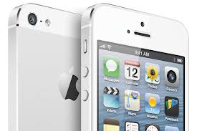
Job Opportunity
Apple needs you!
They are planning
to promote the
iPhone and iPad in
a new series of commercials. Based on our data, should the add focus on the use of Facebook, Twitter, or YouTube apps? Why? What other factors would impact your decision?

Slide 6
SURVEY SAYS….
Let’s take a class poll and fill in our two-way table to help Apple’s marketing department. Of the three choices, which site do you visit most often when online?
 | Facebook | Twitter | YouTube | Total
Male | 0 | 5 | 7 | 12
Female | 1 | 8 | 7 | 16
Total | 1 | 13 | 14 | 28

Slide 7
What does this all mean?
Interpreting Joint Frequencies
____0___ males prefer Facebook
____1___ females prefer Facebook
____5___ males prefer Twitter
____8___ females prefer Twitter
____7___ males prefer YouTube
____7___ females prefer YouTube

Slide 8
What does this all mean?
Marginal Frequencies
____1___ people prefer Facebook.
_____13__ people prefer Twitter.
____14___ people prefer YouTube.

Slide 9
Some people are picky…
In general, unless a total sample size is referenced repeatedly, people relate better to data that is given as a percent. These are called joint probabilities.
To find the joint probability for each element of the table, divide the frequency by the total.
Round to the nearest hundredth!

Slide 10
Original Two-Way Table
Joint Frequencies
 | Facebook | Twitter | YouTube | Total
Male | 0 | 5 | 7 | 12
Female | 1 | 8 | 7 | 16
Total | 1 | 13 | 14 | 28
 | Facebook | Twitter | YouTube | Total
Male | 0 | .18 | .25 | .43
Female | .04 | .29 | .25 | .57
Total | .04 | .46 | .50 | 1

Slide 11
In Other Words…
__0___ % of males prefer Facebook.
___4___ % of females prefer Facebook.
___18___ % of males prefer Twitter.
___29__ % of females prefer Twitter.
___25__ % of males prefer YouTube.
___25__ % of females prefer YouTube.

Slide 12
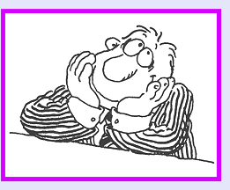
So What?
Data collection’s purpose is to answer a hypothesis. What kind of questions does this answer?
Do males spend more time than females on YouTube?
Do females spend more time on Facebook than anything else?

Slide 13
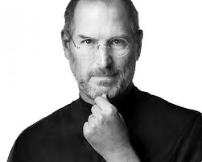
What would Steve Jobs do?
Use the information collected to defend your answer!

